Slide 1
Migrating SQL Server to Azure
Notes:
Hello welcome to today’s Azure Partner Tech Talks session focusing in <solution>.
You can participate in today's event. Please click the messages button your screen and to ask questions regarding the content.
< customize your greeting>

Slide 2
Agenda
Planning and Considerations
Understanding the SQL Server options in Azure
Demos & Tools
DR Planning
Next Steps, Q&A
For demos, comments, updates:
http://aka.ms/talknotes
Notes:
Today’s session will focus on:
Deepening your knowledge on <topic>
Providing insights to help you develop new Azure-focused practices around <topic>
Surfacing programs and offerings for Microsoft US partners to help you drive customer adoption
Addressing questions related to <topic>

Slide 3









Database migration process overview
Post-migration
Optimize
Based on the tests you performed, address any performance issues, and then retest to confirm the performance improvements
Pre-migration
Migration
Discover
Assess
Convert
Migrate schema, data & objects
Data sync
Cutover
Remediate applications
Iteratively make any necessary changes to your applications
Inventory database assets, and application stack discovery
Assess workloads and fix recommendations
Convert the source schema to work in the target environment. This is only relevant for heterogeneous migrations.
Migrate the source schema, and then migrate the source data to the target
Sync your target schema and data with the source. This is only relevant for minimal-downtime migrations
Cut over from the source to the target environment. This is only relevant for minimal-downtime migrations
Run functional & performance tests
Iteratively run functional and performance tests

Slide 4
Microsoft Cloud Adoption Framework for Azure
Adopt
Define strategy
Understand motivations
Business outcomes
Business justification
Prioritize project
Plan
Digital estate
Initial organization alignment
Skills readiness plan
Cloud adoption plan
Ready
Azure readiness guide
First landing zone
Expand the blueprint
Best practice Validation
Migrate
• First workload migration
• Expanded scenarios
• Best practice validation
• Process improvements
Innovate
• Innovation guide
• Expanded scenarios
• Best practice validation
• Process improvements
Govern
Methodology • Benchmark
initial best practice • Governance maturity
Manage
Business commitments
operations baseline • Ops maturity
https://aka.ms/adopt
Notes:
<Key point>: Cloud adoption framework has the guidance that spans from planning to creating the roadmap, to help your businesses in their cloud journey.
Cloud Adoption is iterative process
Each module is an iterative phase that advances your business through the complete lifecycle of cloud adoption.
Customers can choose the phase best-suited to their degree of cloud adoption maturity.
The Cloud Adoption Framework offers a guiding methodology to cloud adoption, with specific approaches to overcoming common blockers to cloud adoption in each module, such as “Define Strategy,” “Plan,”, etc.
Also, since this is modular. Take a step, move forward, revisit the step, maybe going deeper. Take another step, move further forward.
All at your own speed.
The Cloud Adoption Framework offers an incremental approach of how to onboard to the cloud.
Strategy – Do not jump into the cloud for fear of missing out (FOMO). To begin your journey, define your business objectives so that your organization can identify growth opportunities in your business and how to realize them using cloud technologies. This is about defining cloud strategy/vision/roadmap b) get leadership team aligned.
Plan: Next you will need to prepare a plan for your organization for the cloud which includes
aligning people, process and technology
rationalizing your current digital estate
addressing any skills gaps and
embracing new technologies
Ready: Preparing the environment for cloud adoption. This is about getting the team ready to make the move. Example: It includes building the Landing Zone (“helipad” on Azure) for their workloads.
Adopt – This is the phase where you start moving batches of workloads (migration waves), including rightsizing/end-to-end testing prior to cut over. You can either migrate your applications and modernize them or build new innovative solutions using cloud based technologies
Governance and Management--Finally establish a well-managed cloud environment by implementing governance and creating resilient solutions like backup and DR that are constantly optimized. Remember, this is an iterative process so you will need to revisit each stage as your cloud adoption evolve. Whether your organization is new to the cloud or already using cloud technologies, the Microsoft's cloud adoption framework for Azure will meet you where ever you are at on your journey. You need to maintain an ongoing rhythm of governance and management during and after the move. This includes ensuring backup/monitoring/security etc. as well as things like cost management/subscription management.

Slide 5
Discovery phase
Business Objectives - Why move to the cloud?
Capacity, EOL, Compliance, Management, Cost
Technical
Current database profiling, resource utilization, size, architecture
Application architecture
HA/DR Requirements:
Do you offer your users an SLA?
What are your HA requirements?
How much downtime can you afford?
What are your RPO and RTO goals (DR)?
RPO (Recovery Point Objective): How much data am I willing to lose?
RTO (Recovery Time Objective): How much time am I willing to be offline?

Slide 6
Agenda
Planning and Considerations
Understanding the SQL Server options in Azure
Demos & Tools
DR Planning
Next Steps, Q&A

Slide 7
SQL Server in Azure
Choose the right Azure database for your needs
Azure SQL database
Azure SQL managed instance
SQL Server on Azure virtual machines
Best for modern cloud applications
Best for a fully managed SQL Instance
Best for complete SQL Server and OS control
Platform as a service
Infrastructure as a service

Slide 8
Azure SQL Server in a Virtual Machine
IaaS – Complete control over virtualization
Completely customize a SQL Server implementation.
Several templates for common deployments, including Always On Availability Groups.
Choose the VM type and size (Gen Purpose, Compute Optimized, memory optimized, storage optimized).
Choose storage: premium disks, Ultra SSD.
Custom HA/DR deployments: Always On, Replication
Full Support for SSRS, SSIS, SSAS, 3rd party tools.
Choose SQL and OS versions (Windows/Linux).
Filestream, Filegroups/partitions, DTC, Simple Recovery model.
SQL Server on Azure virtual machines
Best for complete SQL Server and OS control

Slide 9
TeamSystem: Italian ERP leader
Europe’s leading provider of ERP solutions
Migrated the application from on-prem to Azure
Chose SQL Server on Azure VM
SQL Server 2017
Ubuntu Linux distribution
“By using SQL Server on Azure, we have direct control over everything. We can monitor and manage every aspect of our database environment, which allows us to continuously optimize its performance.”
Matteo Lazzari: Product owner and CloudOps ERP Product Team Lead, TeamSystem
“With SQL Server on Azure, we can give customers all the functionality they expect from our software, but with the agility of a cloud solution.”
Matteo Lazzari: Product owner and CloudOps ERP Product Team Lead, TeamSystem
https://customers.microsoft.com/en-us/story/809018-teamsystem-partner-professional-services-sql-server-azure-virtual-machines

Slide 10
Azure SQL Database
PaaS – Single database abstraction
Initial SQL offering in Azure (2009)
Scoped as single logical database
Provision and scale dynamically
Two purchasing models:
DTU (Database Transaction Unit)
Blended measure of CPU, IO, and RAM
Several tiers available – Basic, Standard, Premium
vCore
General Purpose (equivalent to Standard tiers)
Business Critical (equivalent to Premium tiers)
Tremendous improvements in 10+ years
Max size grew from 10GB to 100TB!
Azure SQL Database
Best for modern cloud applications

Slide 11
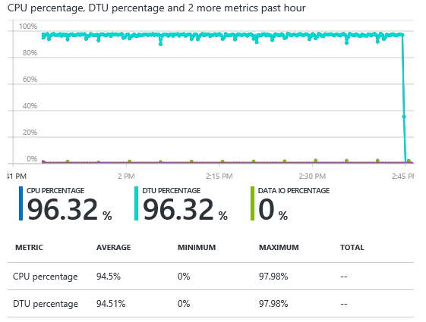
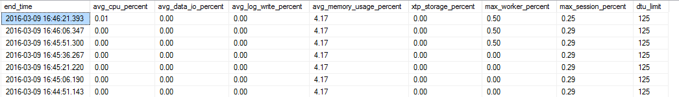
DTU (Database Transaction Unit)
CPU
Data IO
Log Writes
Master.sys.resource_stats ( 5 min average)
Sys.dm_db_resource_stats ( 15 second average)

Slide 12
vCore Licensing Model
The vCore model provides several benefits:
Higher compute, memory, IO, and storage limits.
Control over the hardware generation to better match compute and memory requirements of the workload.
Pricing discounts for Azure Hybrid Benefit (AHB) and Reserved Instance (RI).
Greater transparency in the hardware details that power the compute; facilitates planning for migrations from on-premises deployments.
Two tiers:
General Purpose (equivalent to Standard tiers)
Business Critical (equivalent to Premium tiers)
Azure SQL Database
Best for modern cloud applications

Slide 13
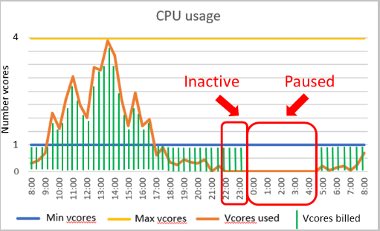
vCore Licensing Model - Serverless
The vCore model also offers a serverless tier.
Automatically scales compute based on workload and bills for amount of compute used per second.
Automatically pauses during inactive periods (no compute charges, however storage is still billed).
Autoscaling range determines min/max vCores, autopause delay determines how long to wait before pausing.
Example:
Single databases with unpredictable and intermittent usage, with potentially long periods of inactivity.

Slide 14
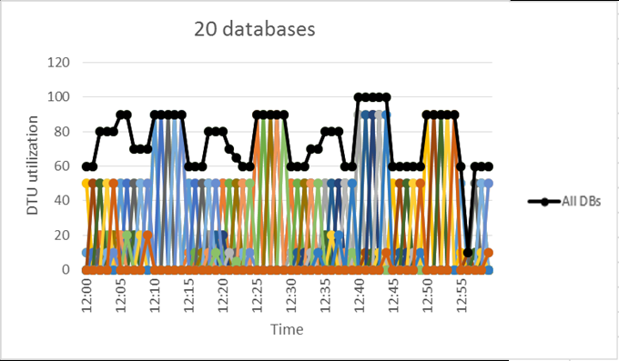
Azure SQL Database Elastic Pools
SQL Database (PaaS)
Pools resources into logical groups
Allows databases within the pools to share DTU / vCore allocation
Ideally suited for large collections of databases with some workload variance.
vCore Resource Limits
DTU Resource Limits
Singleton
Elastic Pool

Slide 15
Paychex: Business Critical app with Explosive Growth
Serves 650,000 businesses across US and Europe
Application: Time tracking and payroll (Flex Time)
13 Million timecards a day, each processed is less than 2 seconds
Business-critical application with explosive growth
Multi-tenant application with single-database per tenant architecture
Migrated several thousand databases from on-prem to Azure
Chose Azure SQL Database Elastic Pools
“Microsoft's Platform as a Service was a differentiator to allow us realize our vision for a world-class time and labor application.”
Dave Wilson: Sr. Director of IT Infrastructure and Architecture, Paychex
“Azure SQL Database lets us consume public cloud the way that fits for us, so we can deliver a world-class app at scale with performance and availability.”
Dave Wilson: Sr. Director of IT Infrastructure and Architecture, Paychex
https://customers.microsoft.com/en-us/story/paychex-azure-sql-database-us

Slide 16
VLDB: Hyperscale for High performance scaling
Hyperscale is a new, cloud-native solution from Azure that addresses common scalability limits
Purpose-built
Scales compute, storage, memory or all three
Use without rearchitecting your app
Optimized for different scenarios
Customized by database engine
Takes the worry out of database scaling
Up to 100TB in size
9
TB

Slide 17
Azure SQL Database Managed Instance
SQL Database (PaaS)
A flavor of SQL DB designed to enable easy migration to fully managed PaaS, for almost any application!
Managed Instance
Singleton
Elastic Pool
Easy lift and shift
Fully managed PaaS
Full isolation and security
New business model
Fully-fledged SQL instance with nearly 100% compat with on-prem
Built on the same PaaS service infrastructure
All PaaS features
Native VNET implementation
Private IP addresses
Public endpoint
Competitive
Transparent
Frictionless
Notes:
The vCore model provides several benefits:
Higher compute, memory, IO, and storage limits.
Control over the hardware generation to better match compute and memory requirements of the workload.
Pricing discounts for Azure Hybrid Benefit (AHB) and Reserved Instance (RI).
Greater transparency in the hardware details that power the compute; facilitates planning for migrations from on-premises deployments.
Two licensing models:
General Purpose (equivalent to Standard tiers)
Business Critical (equivalent to Premium tiers)

Slide 18
H&R Block: Tax Preparation Service
US based tax services provider
Has delivered over 800 million tax returns since 1955
Migrated the application from on-prem to Azure
Chose Azure SQL managed instance
“SQL Database managed instance gives us a smooth migration path for moving existing workloads to Azure with minimal technical reengineering.”
Sameer Agarwal: Manager-Enterprise Data Analytics, H&R Block
“Azure makes it easier to continue our work using AI, machine learning, and other ways to serve our customers better.”
Sameer Agarwal: Manager-Enterprise Data Analytics, H&R Block
https://customers.microsoft.com/en-us/story/724156-hr-block-professional-services-azure-sql-server

Slide 19
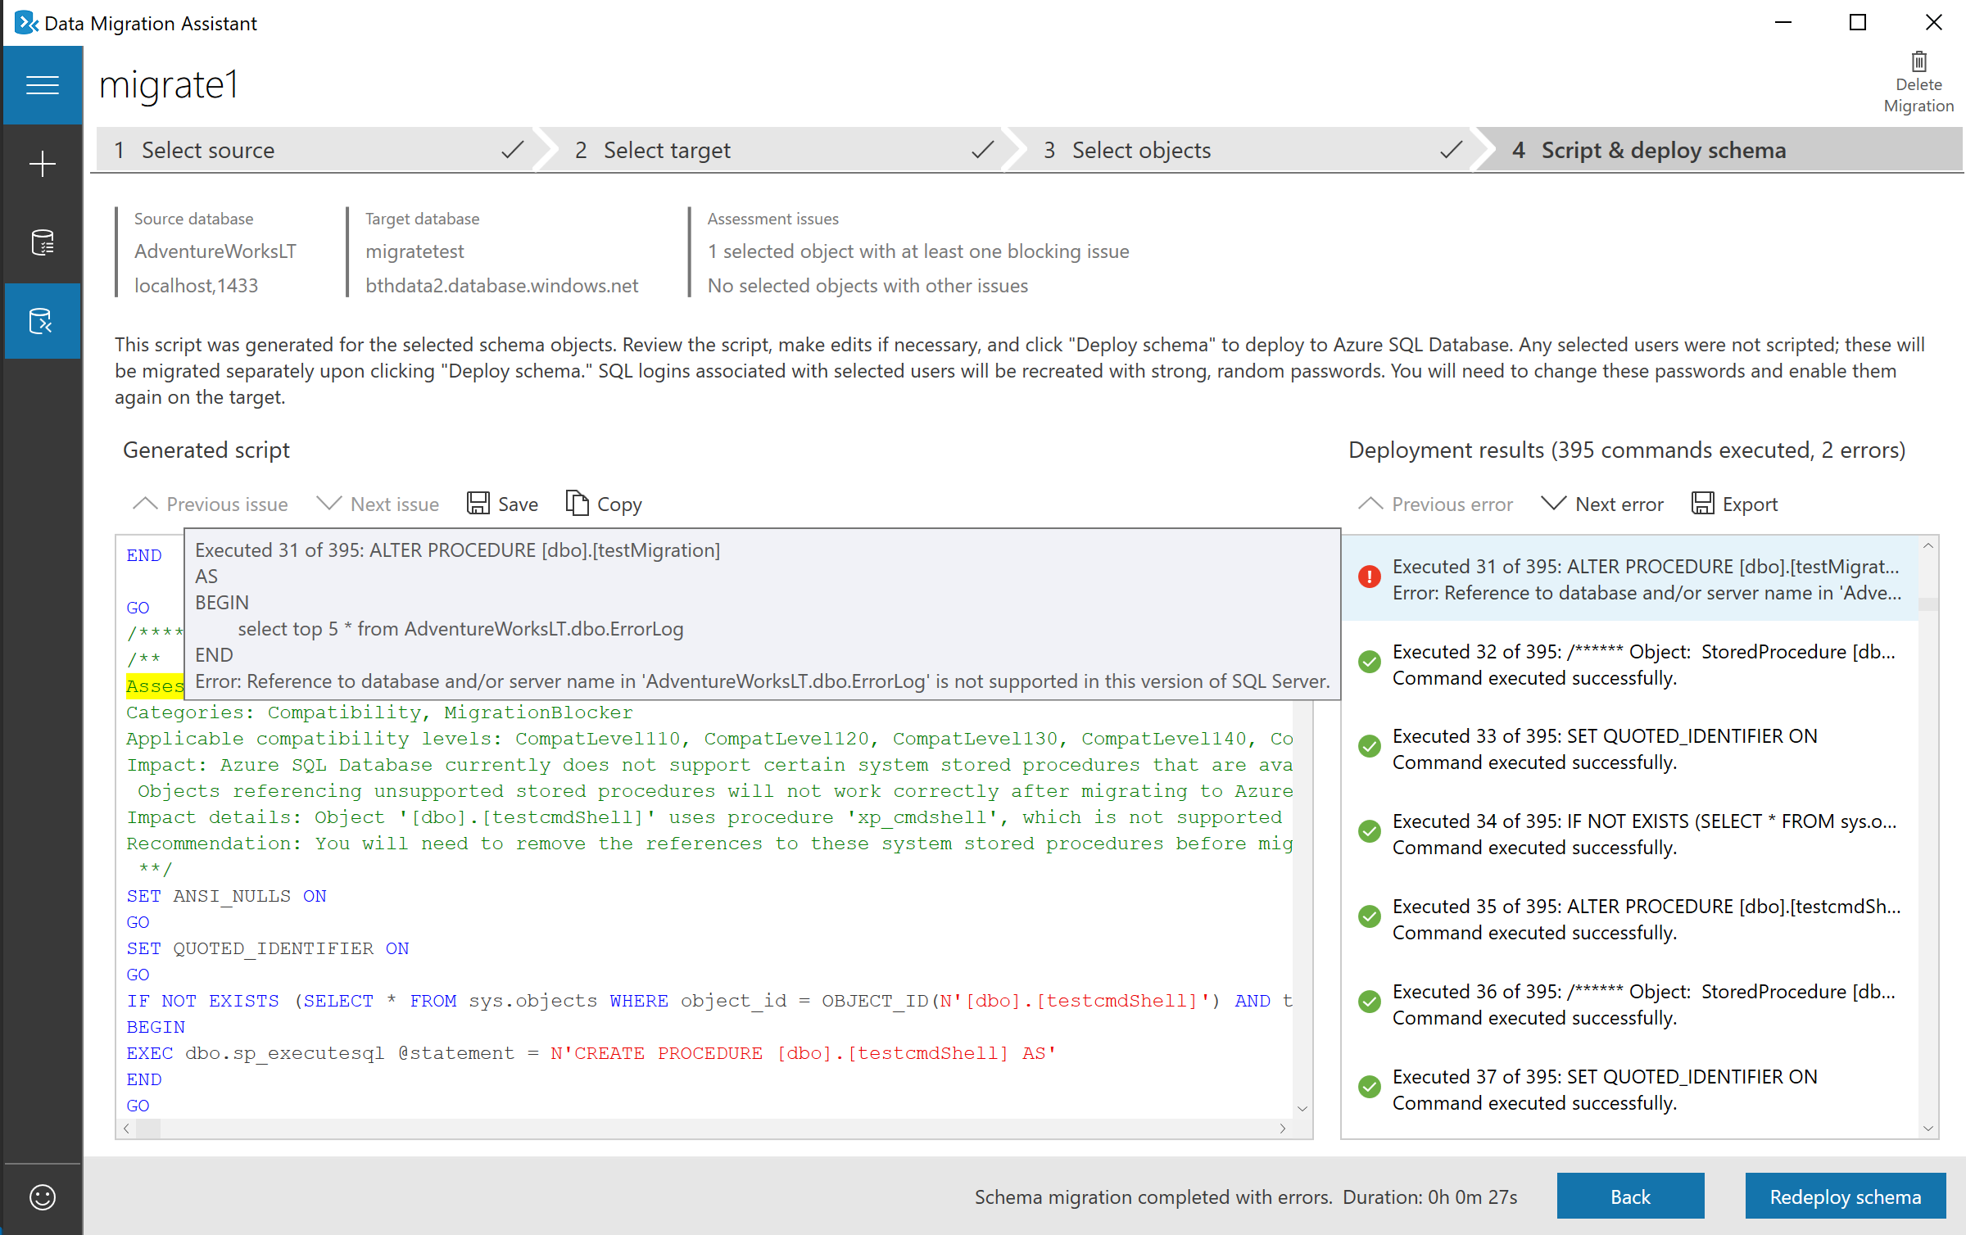
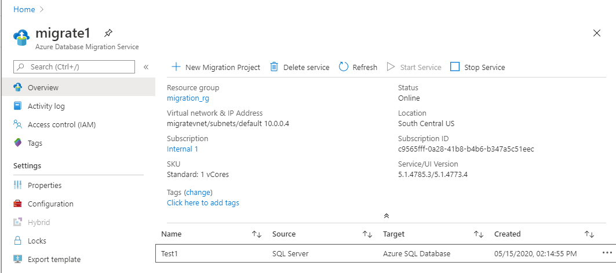
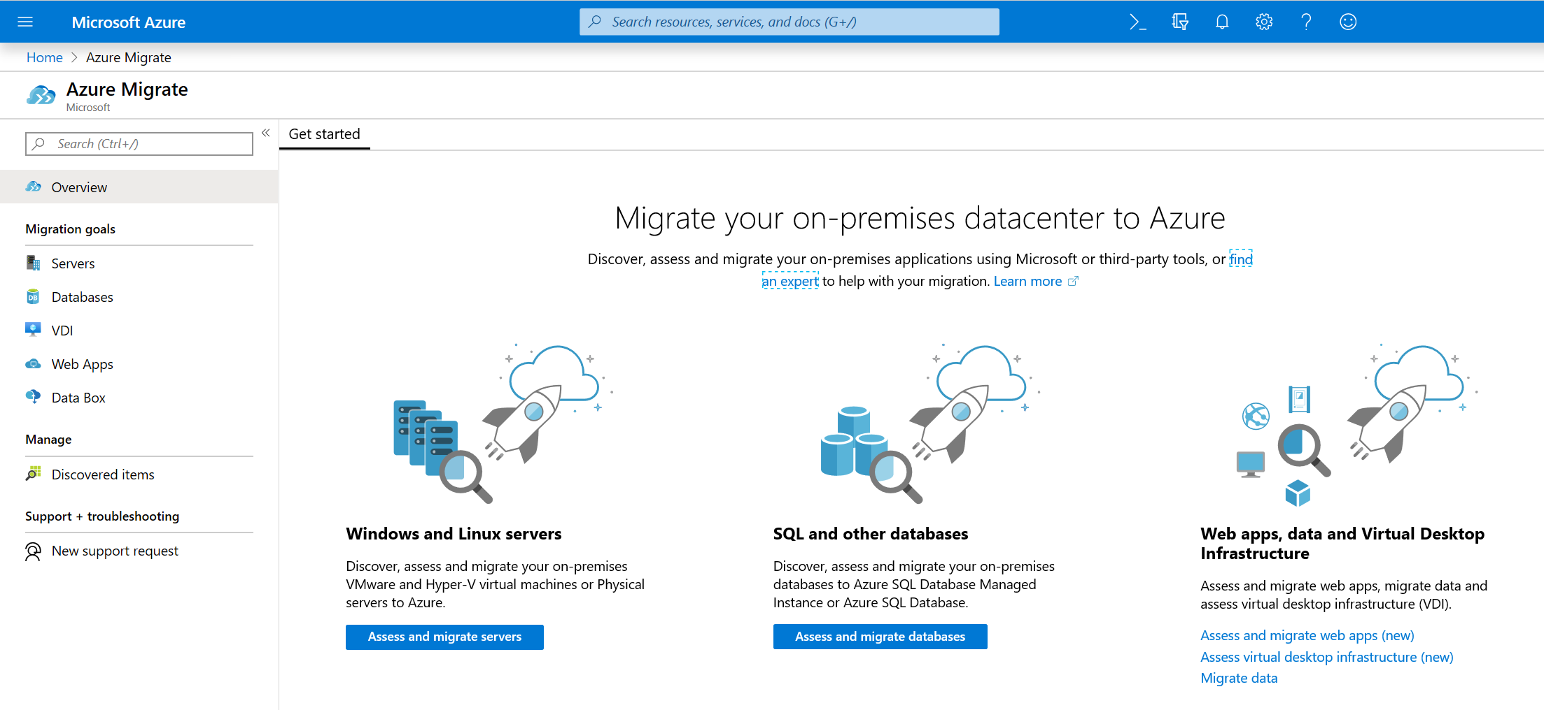
DEMO – Setup Test Environment
Use Docker to configure a test database locally
Configure target database in Azure
Later, we’ll look at a few tools:
DMA – Database Migration Assistant
DMS – Database Migration Service
Azure Migrate

Slide 20


High Availability & Disaster Recovery
High Availability
Disaster Recovery
Ability to quickly recover the database from a failure to provide business continuity
Enable business continuity during large-scale disruptions including region outages due to natural disasters
Protect business by minimizing data loss
Failover across regions with RPO in sec/minutes and RTO in minutes/hours
Continuous availability of the database with reliance to local failures
Automatic recovery from local hardware and software failures transparent to applications using the database
In-region millisecond or sub-millisecond failovers with no disruption to users

Slide 21
Built in High Availability Platform
Single logical database
DB
P
S
Ack
value
Read
write
P
S
P
Recovery from machine failure
Critical capabilities:
Create new replica
Synchronize data
Stay consistent
Detect failures
Failover
99.99% availability
Ack
Ack
S
Write
Write
S
Reads are completed at the primary
Writes are replicated to secondaries
Notes:
Azure SQL Database has a built-in high availability subsystem that protects your database from failures of individual servers and devices in a datacenter.
Azure SQL Database maintains multiple copies of all data in different physical nodes located across fully independent physical sub-systems to mitigate outages due to failures of individual server components, such as hard drives, network interface adapters, or even entire servers.
At any one time, three database replicas are running—one primary and two or more replicas.
Data is written to the primary and one secondary replica using a quorum based commit scheme before the transaction is considered committed.
If the hardware fails on the primary replica, Azure SQL Database detects the failure and fails over to the secondary replica.
In case of a physical loss of a replica, a new replica is automatically created.
So there are always at minimum two physical, transactionally consistent copies of your data in the datacenter.

Slide 22
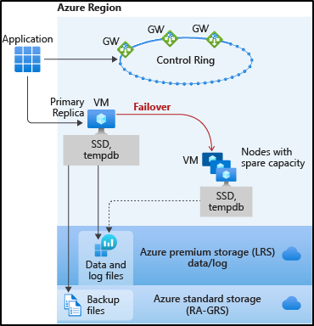
HA for Basic, Standard, and General Purpose
Remote storage provides data redundancy within a datacenter
Recovery depends on spare capacity

Slide 23
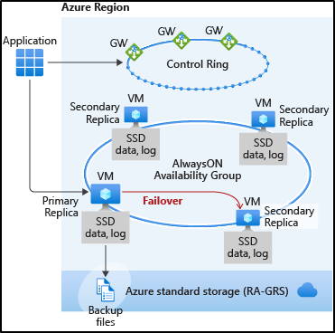
HA for Business Critical and Premium
Replicas automatically created
AlwaysON replication
Automatic failover
Read Scale-Out

Slide 24
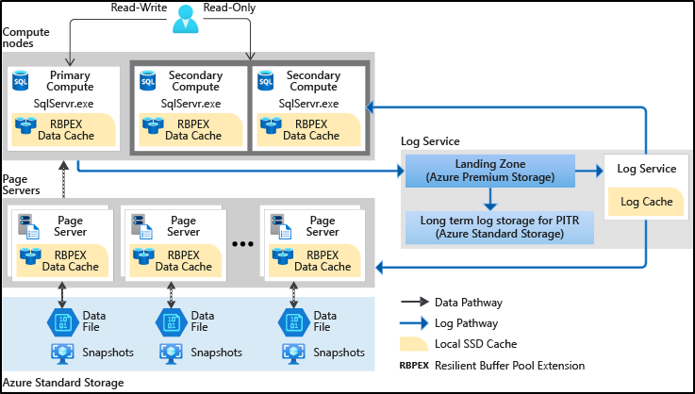
HA for Hyperscale
Separated compute and storage
Paired page servers
Redundant log and data storage
Notes:
Support for up to 100 TB of database size
Nearly instantaneous database backups (based on file snapshots stored in Azure Blob storage) regardless of size with no IO impact on compute resources
Fast database restores (based on file snapshots) in minutes rather than hours or days (not a size of data operation)
Higher overall performance due to higher log throughput and faster transaction commit times regardless of data volumes
Rapid scale out - you can provision one or more read-only nodes for offloading your read workload and for use as hot-standbys
Rapid Scale up - you can, in constant time, scale up your compute resources to accommodate heavy workloads when needed, and then scale the compute resources back down when not needed.

Slide 25
What is an Availability Zone?
Availability Zones is a high availability offering that protects applications against datacenter level failures.
Region
Minimum of three physically separated locations
Three Availability Zones to support quorum-based workloads like SQL, Service Fabric, Cassandra, MongoDB.
Independent power, cooling, network
A facility level failure or single fiber path failure will affect only one zone.
Azure management services replicated across zones
Azure management services are redundant, so a single zone failure will not affect other zones. Azure maintenance orchestrated zone by zone.
Notes:
A region is a set of datacenters deployed within a latency-defined perimeter and connected through a dedicated regional low-latency network. An Availability Zone is a high-availability offering that protects your applications and data from datacenter failures. Availability Zones are unique physical locations within an Azure region. Each zone is made up of one or more datacenters equipped with independent power, cooling, and networking. To ensure resiliency, there's a minimum of three separate zones in all enabled regions. The physical separation of Availability Zones within a region protects applications and data from datacenter failures. Zone-redundant services replicate your applications and data across Availability Zones to protect from single-points-of-failure. With Availability Zones, Azure offers industry best 99.99% VM uptime SLA. The full Azure SLA explains the guaranteed availability of Azure as a whole.

Slide 26
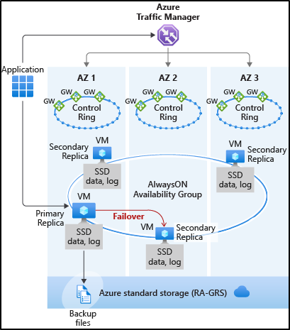
Zone redundant configuration
Free for Business Critical/Premium
Replicas are automatically created in 3 different zones
Must be enabled / configured
See CAP / PACELC theorem

Slide 27
Agenda
Planning and Considerations
Understanding the SQL Server options in Azure
Demos & Tools
DR Planning
Next Steps, Q&A

Slide 28
Common Migration Tools
SSMA – SQL Server Migration Assistant
Source: Access, DB2, MySQL, Oracle, Sybase ASE
Target: SQL 2008-2019, Azure SQL Database, SQL Managed Instance
DMA – Data Migration Assistant
SQL Server 2005, AWS RDS for SQL, up to SQL 2019
Discover blocking issues, feature changes, recommendations
DMS – Data Migration Service
New PaaS Service. Standard and Premium tiers.
Current: SQL, MySQL, PostgreSQL, AWS RDS, Oracle, MongoDB
Future: expanding to include DB2, Sybase, Cosmos DB, etc.
DEA – Database Experimentation Assistant
A/B testing and analysis to evaluate workloads across versions.
Data Access Migration Toolkit
VS Code source analysis to find compatibility issues when targeting Azure SQL Database.
Notes:
Azure Data Studio

Slide 29
DEMO
DMA – Database Migration Assistant
DMS – Database Migration Service

Slide 30
Database Compatibility
SQL Server Version | Default Compat Level | Version
SQL Server 2019 | 150 | 15
SQL Server 2017 | 140 | 14
SQL Server 2016 | 130 | 13
SQL Server 2014 | 120 | 12
SQL Server 2012 | 110 | 11
SQL Server 2008 R2 SQL Server 2008 | 100 | 10
Upgrade (including restore) retains compat level of database
Use this to maintain functional compatibility
Reserved words
Query execution functionality
Protect against breaking changes that are database scoped
Does not protect from discontinued features
Query Performance
Not a guarantee of performance
Microsoft will work with you if you encounter query plan changes
120 introduces new cardinality estimator for Queries
130 and 140 introduce new query plan and execution features
130 and 140 include by default QP fixes under trace flag 4199
Trace flag 4199 applies for new fixes
Query Store to observe performance differences
Does not affect server wide functionality

Slide 31
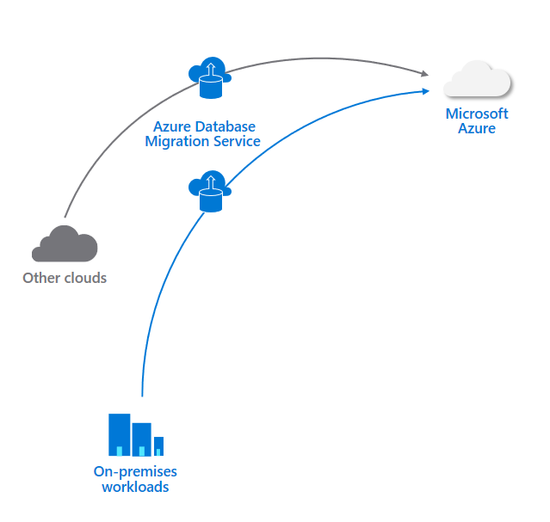



Azure Database Migration Service
A comprehensive service, including a detailed guide, designed for seamlessly migrating your databases to Azure
Highly resilient and self-healing migration experience, with near-zero downtime
Completely automate your database migration project and find the migration scenario that best fits your needs

Slide 32
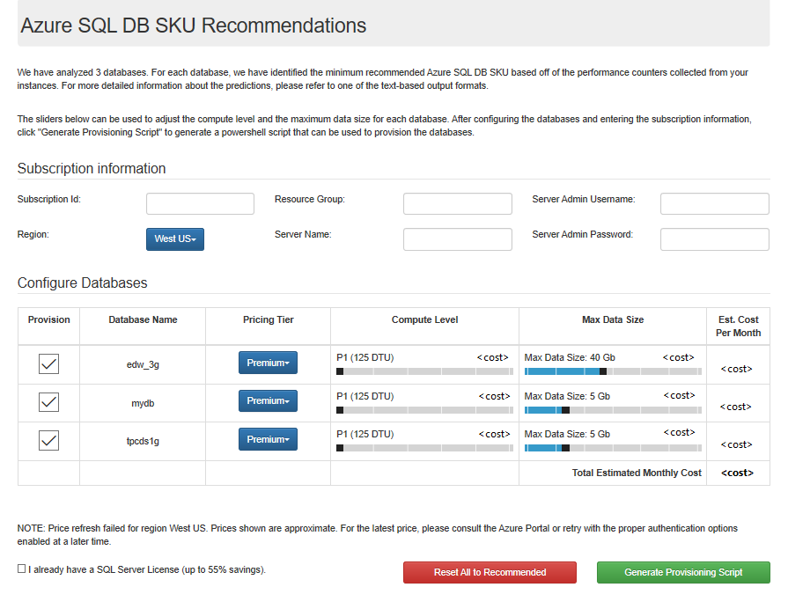
DMA – Database Migration Assistant
SKU recommendations

Slide 33
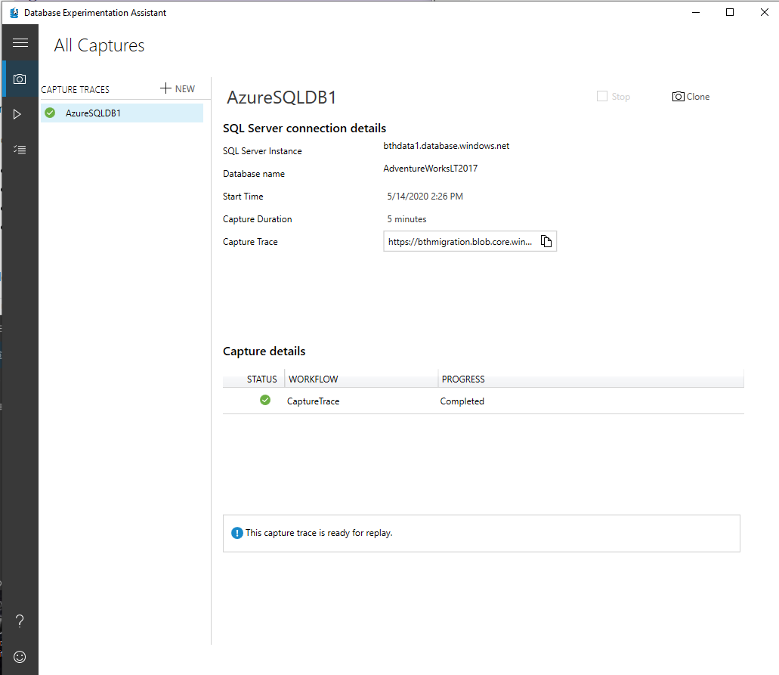
Common Migration Tools
DEA – Database Experimentation Assistant
Compare workloads to evaluate performance/compatibility
Captures Trace or XEvents
Supports SQL Server, Azure SQL DB, Managed Instance

Slide 34
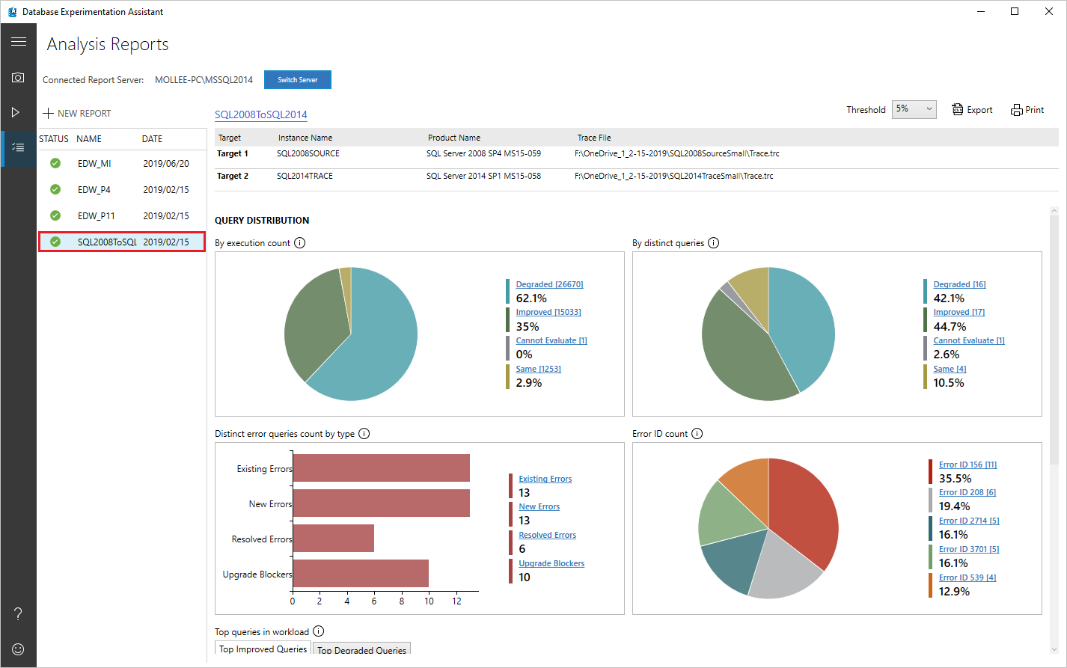
Common Migration Tools
DEA – Database Experimentation Assistant - Analysis

Slide 35
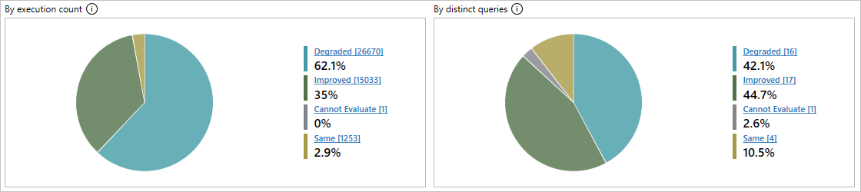
Common Migration Tools
DEA – Database Experimentation Assistant - Analysis
Degraded: Queries that performed worse on Target 2 than on Target 1.
Errors: Queries that showed errors at least one time on at least one of the targets.
Improved: Queries that performed better on Target 2 than on Target 1.
Cannot Evaluate: Queries that had a sample size too small for statistical analysis. For A/B testing analysis, DEA requires the same queries to have at least 15 executions on each target.
Same: Queries that have no statistical difference between Target 1 and Target 2.

Slide 36
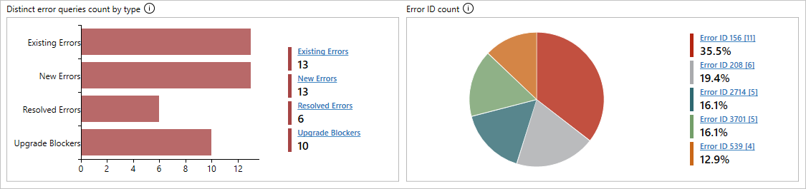
Common Migration Tools
DEA – Database Experimentation Assistant - Analysis
Existing Errors: Errors that exist on both Target 1 and Target 2.
New Errors: Errors that are new on Target 2.
Resolved Errors: Errors that exist on Target 1 but are resolved on Target 2.
Upgrade Blockers: Errors that block upgrade to target server.

Slide 37
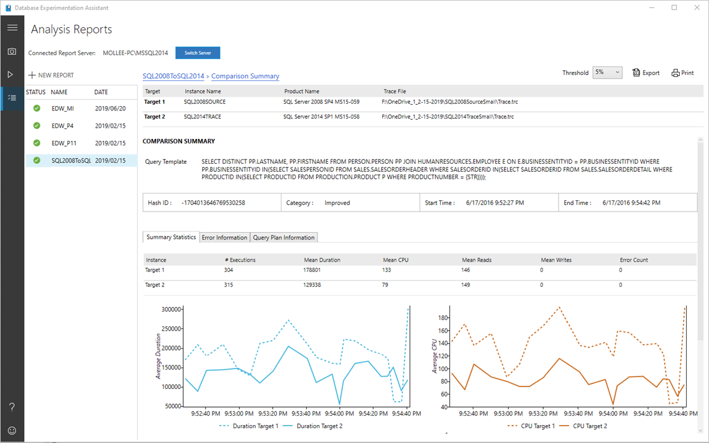
Common Migration Tools
DEA – Database Experimentation Assistant - Analysis

Slide 38
Agenda
Planning and Considerations
Understanding the SQL Server options in Azure
Demos & Tools
DR Planning
Next Steps, Q&A

Slide 39
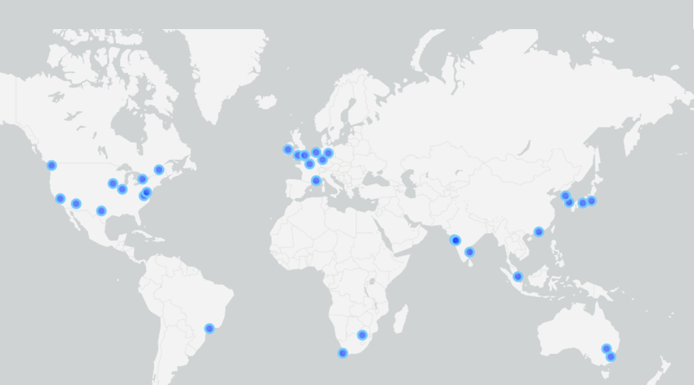
Overview of DR capabilities
Geo-Replication
Auto-failover Groups
Point-in-Time Restore
Long-term Retention

Slide 40
Active Geo Replication for Azure SQL Database
Focus on building apps instead of management tasks
Active geo-replication provides the richest business continuity solution with the least risk of data loss and the most rapid recovery time
Extends standard geo-replication with up to four readable secondary databases in the same or different data center locations (regions)
Secondary databases can also be used for load balancing or to provide low-latency access to replicated data anywhere in the world
Automatically manage geo-replication relationship, connectivity, and failover at scale

Slide 41
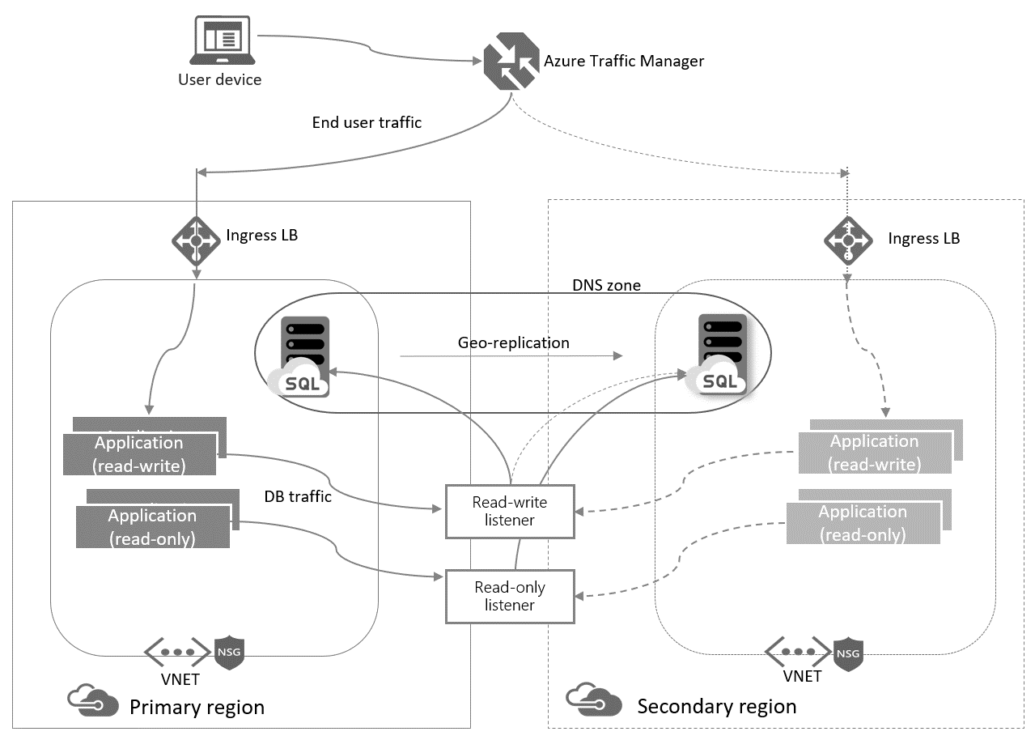
Auto Failover Groups
Enable geo-replication for a group of databases or pools to another region
Automatic or manual failover policy
Read-only and read-write listener endpoints for transparent failover
Available for all service tiers
Notes:
Auto-failover groups is a SQL Database feature that allows you to manage replication and failover of a group of databases on a SQL Database server or all databases in a managed instance to another region. It is a declarative abstraction on top of the existing active geo-replication feature, designed to simplify deployment and management of geo-replicated databases at scale.
When adding databases, elastic pools, or managed instances to a failover group, there is an initial seeding phase before data replication starts. The initial seeding phase is the longest and most expensive operation. Once initial seeding completes, data is synchronized, and then only subsequent data changes are replicated. The time it takes for the initial seed to complete depends on the size of your data, number of replicated databases, and the speed of the link between the entities in the failover group. Under normal circumstances, typical seeding speed is 50-500 GB an hour for a single database or elastic pool, and 18-35 GB an hour for a managed instance. Seeding is performed for all databases in parallel. You can use the stated seeding speed, along with the number of databases and the total size of data to estimate how long the initial seeding phase will take before data replication starts.

Slide 42
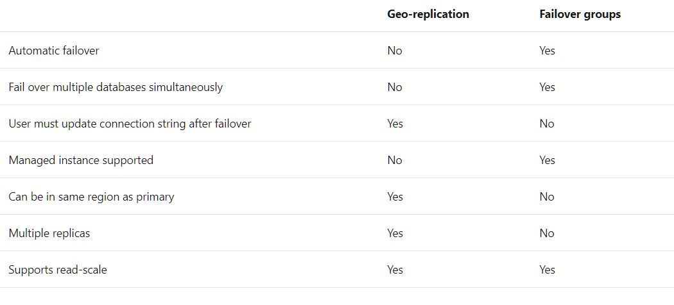
Geo Replication vs Auto Failover Groups
Notes:
Reference:
https://docs.microsoft.com/en-us/azure/sql-database/sql-database-auto-failover-group
https://docs.microsoft.com/en-us/azure/sql-database/sql-database-designing-cloud-solutions-for-disaster-recovery

Slide 43
Point-in-time restore
Automatic backups
Full backups weekly, differential backup daily, log backups every 5 minutes
Daily and weekly backups automatically uploaded to geo-redundant Azure Storage
Self-service restore
Point-in-time up to a second granularity
REST API, PowerShell, or Azure portal
Creates a new database in the same logical server
User-controlled retention policy
7 days default retention in all service tiers
Up to 35 days of additional retention if required at additional cost
sabcp01bl21
sabcp01bl21
Azure SQL Database backups
Azure storage
Geo- replicated
Restore from backup
Notes:
Supports business continuity by recovering a database from a recent backup after accidental data corruption or deletion.
Automatic backups
Full backups weekly
Differential backup daily
Log backups every 5 minutes
Daily and weekly backups automatically uploaded to geo-redundant Azure Storage
Self-service restore
Point-in-time up to a second granularity
REST API, Windows PowerShell, or Portal
Creates a new database in the same logical server
Tiered retention policy
Basic - 7 days
Standard - 35 days
Premium, Premium RS - 35 days
No additional cost to retain backups
Objective: Point In Time Restore is designed to return your database to an earlier point in time. It uses the database backups, incremental backups and transaction log backups that the service automatically maintains for every user database. This capability is available for all service tiers. You can go back 7 days with Basic, 35 days with Standard, Premium, and Premium RS. Refer to Recover from human error for details of how to use Point In Time Restore.
Built-in Automatic Backup in Azure SQL Database
Azure SQL Database automatically creates backups of every active database using the following schedule: Full database backup once a week, differential database backups once a day, and transaction log backups every 5 minutes. The full and differential backups are replicated across regions to ensure availability of the backups in the event of a disaster.
Restoring an Active Database to a Point in Time
For a database that is currently active, the earliest restore point available for the database is displayed in the Quick Glance section of the Dashboard for the database on the Azure Management Portal.
For a complete walkthrough of restoring a database, see Submit a Database Restore Request.

Slide 44
Long-term data retention
Automatically created with LTR capability in Azure SQL Database
Full database backups
Store backups for up to for up to 10 Years
Read-access geo-redundant storage (RA-GRS)
LTR for Managed Instance currently in private preview.
Notes:
Long Term Retention (LTR) capability in Azure SQL Database
https://docs.microsoft.com/en-us/azure/sql-database/sql-database-long-term-retention
Read-access geo-redundant storage (RA-GRS). RA-GRS provides read-only access to the data in the secondary location, in addition to geo-replication across two regions.
Keep the DB running
Create an adhoc backup with extended retention period
Use Export functionality to generate a bacpac and store it

Slide 45
Geo-restore protects from disaster
Self-service restore API
Built on geo-redundant Azure Storage
Restores last replicated backup to any Azure region as a new database
No extra cost, no capacity guarantee
RTO≥12h, RPO=1h
Geo- replicated
sabcp01bl21
sabcp01bl21
Azure SQL Database backups
Azure storage
Restore to any Azure region
Notes:
Geo-Restore
Geo-Restore is the most basic disaster recovery option available in Azure SQL Database. It is available with Basic, Standard, and Premium service tiers. The weekly full backup and at least one daily differential backup are stored in a Geo-redundant storage to protect against region wide failures. When you submit a restore request, the database will be restored to the most recent daily backup.
There are no charges for the additional backups that are stored, but if you use Geo-Restore, you will be charged for the restored database at normal rates once the restore is complete.
For a complete walkthrough, see Submit a Database Restore Request. You can automate this operation using the PowerShell cmdlet <name> or REST API <operation name>.
For more information, see Managing Azure SQL Databases with PowerShell and Managing Azure SQL Databases with REST API.
Talking Points:
Geo-Restore is also available with Basic, Standard, and Premium databases. It provides the default recovery option when also database is unavailable because of an incident in the region where your database is hosted.
The weekly full backup and at least one daily differential backup are stored in a Geo-redundant storage to protect against region wide failures. When you submit a restore request, the database will be restored to the most recent daily backup.
Similar to Point In Time Restore, Geo-Restore relies on database backups in geo-redundant Azure storage. It restores from the geo-replicated backup copy and therefore is resilient to the storage outages in the primary region. Refer to Recover from an outage for details of how to use Geo-Restore.
There are no charges for the additional backups that are stored, but if you use Geo-Restore, you will be charged for the restored database at normal rates once the restore is complete.
For a complete walkthrough, see Submit a Database Restore Request. You can automate this operation using the PowerShell cmdlet <name> or REST API <operation name>.
For more information, see Managing Azure SQL Databases with PowerShell and Managing Azure SQL Databases with REST API.

Slide 46
BCDR features and deployment options
Service tier | General purpose |  | Business critical |  | Hyperscale
Deployment option | Single / Elastic Pools | Managed Instance | Single / Elastic Pools | Managed Instance | Single
Point in Time Restore (PiTR) | Automatic PiTR backups Backups stored on RA-GRS storage Retention period: 1-35 days (default 7 days) |  | Automatic PiTR backups Backups stored on RA-GRS storage Retention period: 1-35 days (default 7 days) |  | Automatic PiTR backups Backups stored on RA-GRS storage Retention period: 7 days
Restore from LTR Backup | Up to 10 years | Available in limited public preview on MI | Up to 10 years | Available in limited public preview on MI | Not Available
Geo-Restore | RPO < 1h RTO < 12h |  | RPO < 1h RTO < 12h |  | RPO < 1h RTO < 12h
Active Geo Replication | RPO < 5s RTO < 30s | Not available on MI | RPO < 5s RTO < 30s | Not available on MI | Available in Private Preview
Auto Failover Groups | RPO < 5s RTO < 1h |  | RPO < 5s RTO < 1h |  | Not Available

Slide 47
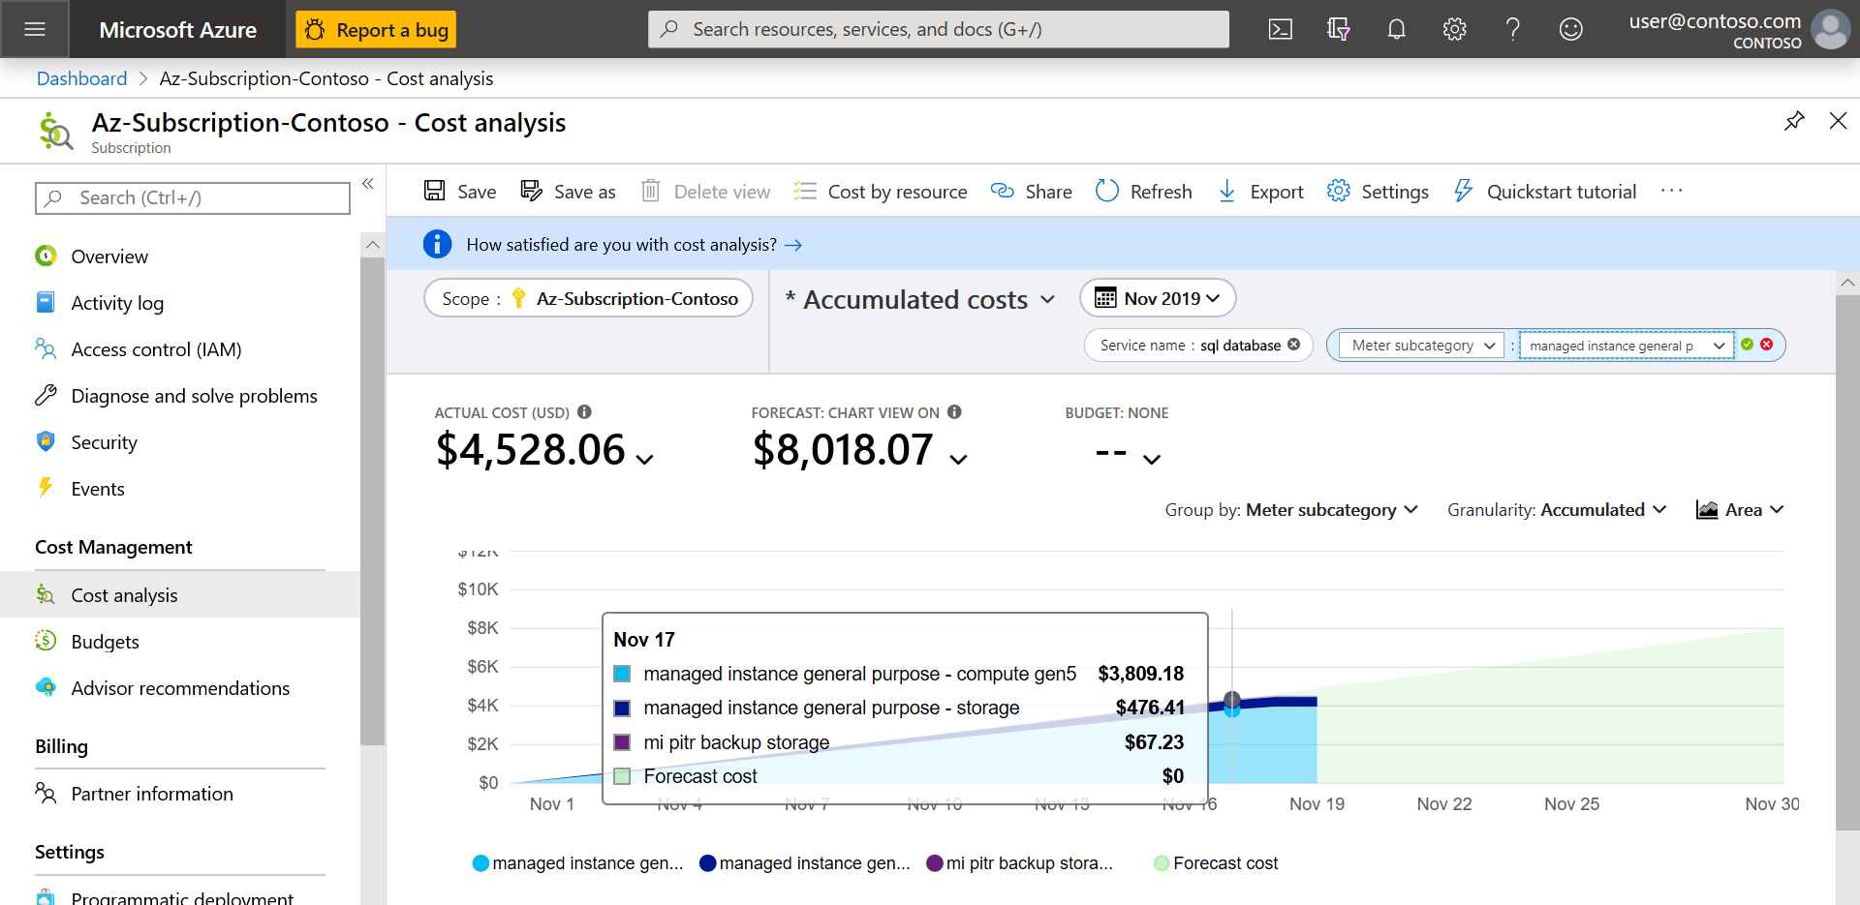
Backup Cost Management
To understand backup storage costs, go to Cost Management + Billing on Azure Portal and select Cost Management->Cost Analysis
https://docs.microsoft.com/en-us/azure/sql-database/sql-database-automated-backups?tabs=single-database#monitor-costs

Slide 48
Q&A
Partner Tech Talks

Slide 49
Notes:
Thanks for attending Today’s Azure Partner Tech Talks.
We will now monitor the Q&A chat to answer any additional question you might have.
Within 72 hours the recording of this presentation will be available to watch using the same link you used to register for today’s session.
Be sure to stay informed about Microsoft partner news, recommendations, opportunities and programs that are relevant to your business. Visit aka.ms/uspstayinformed to choose your favorite ways or way to get the information you need.
I would like thank you today's presenters, and again we'd like to thank you for attending today’s Azure Partner Tech Talks session.
See you next time.

